Slide 1
Project_YoutubeVideoStatistics
3 min part of the team presentation
Polina A Holland

Slide 2
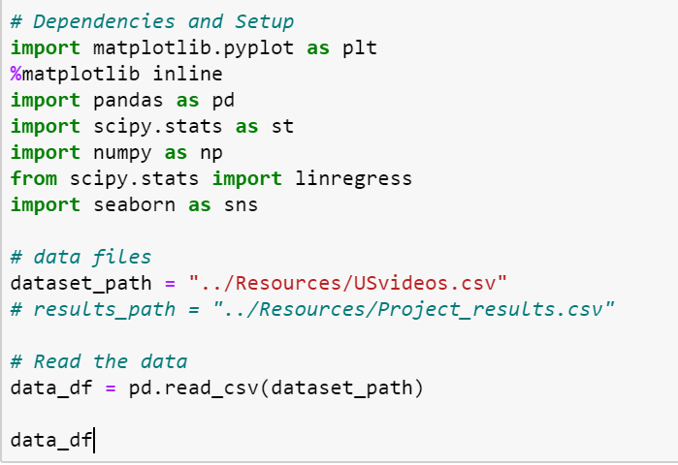
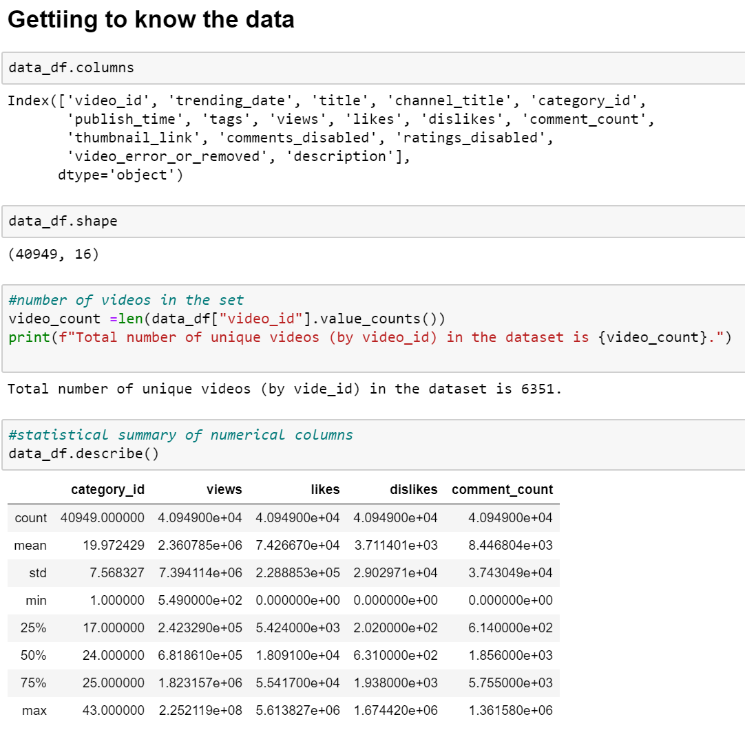
Project_YoutubeVideoStatistics

Slide 3
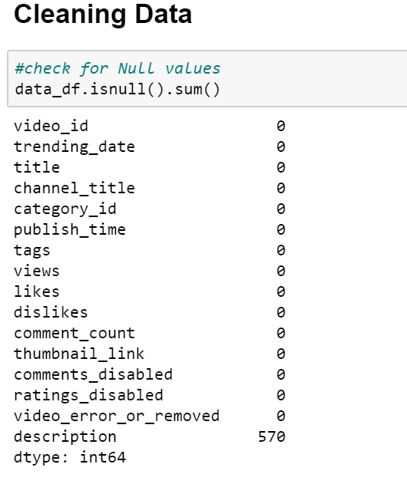
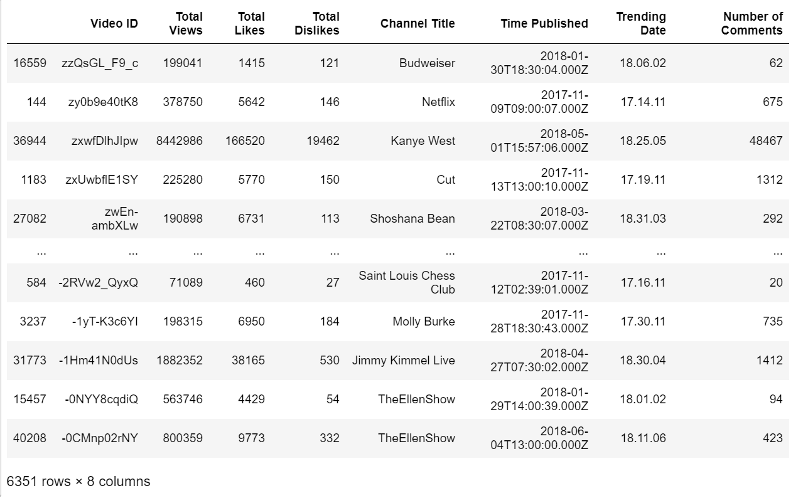
Project_YoutubeVideoStatistics

Slide 4
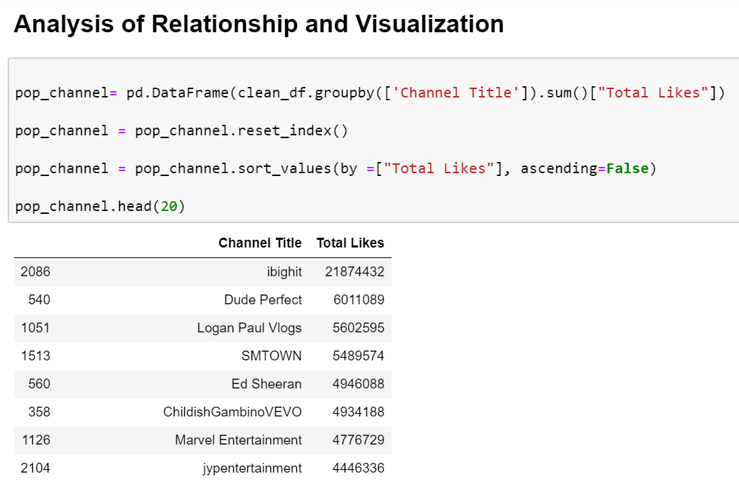
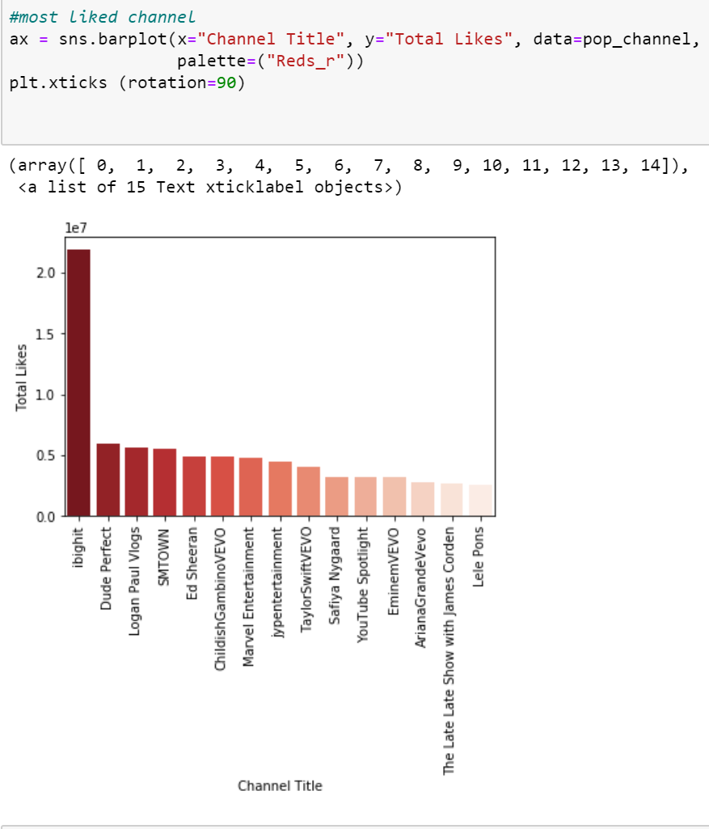
Project_YoutubeVideoStatistics

Slide 5
Project_YoutubeVideoStatistics

Slide 6
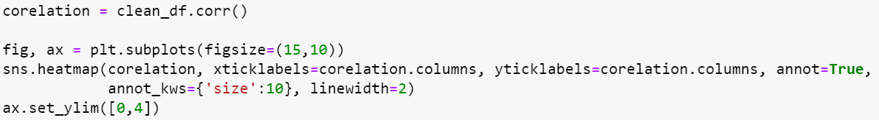
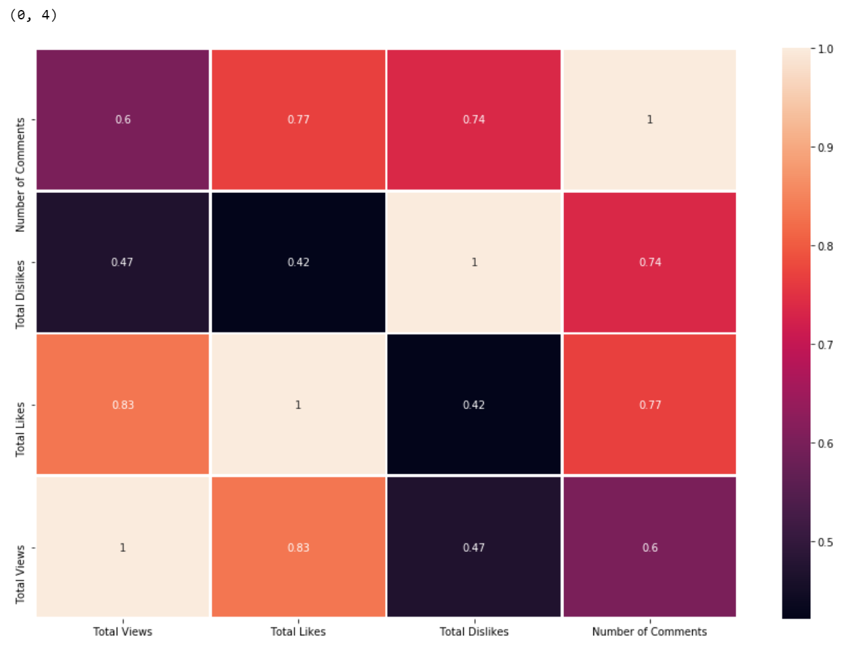

Slide 7
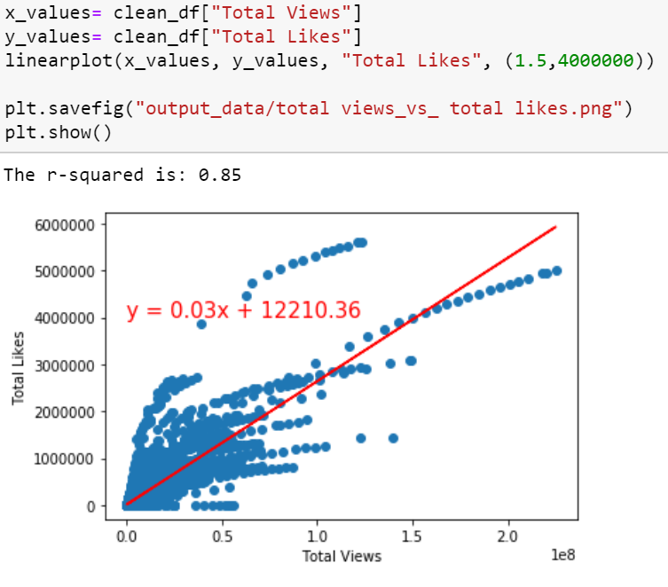
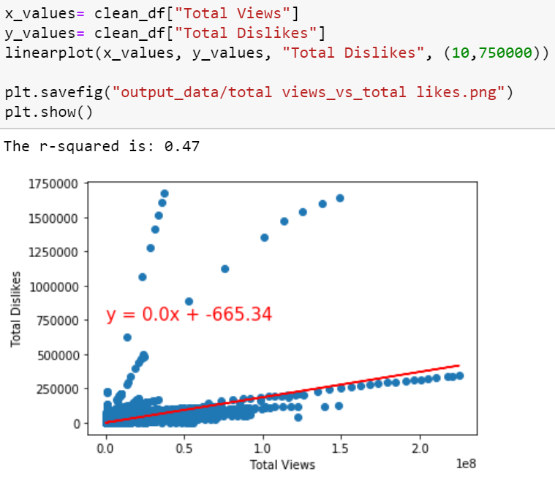
Project_YoutubeVideoStatistics

Slide 8
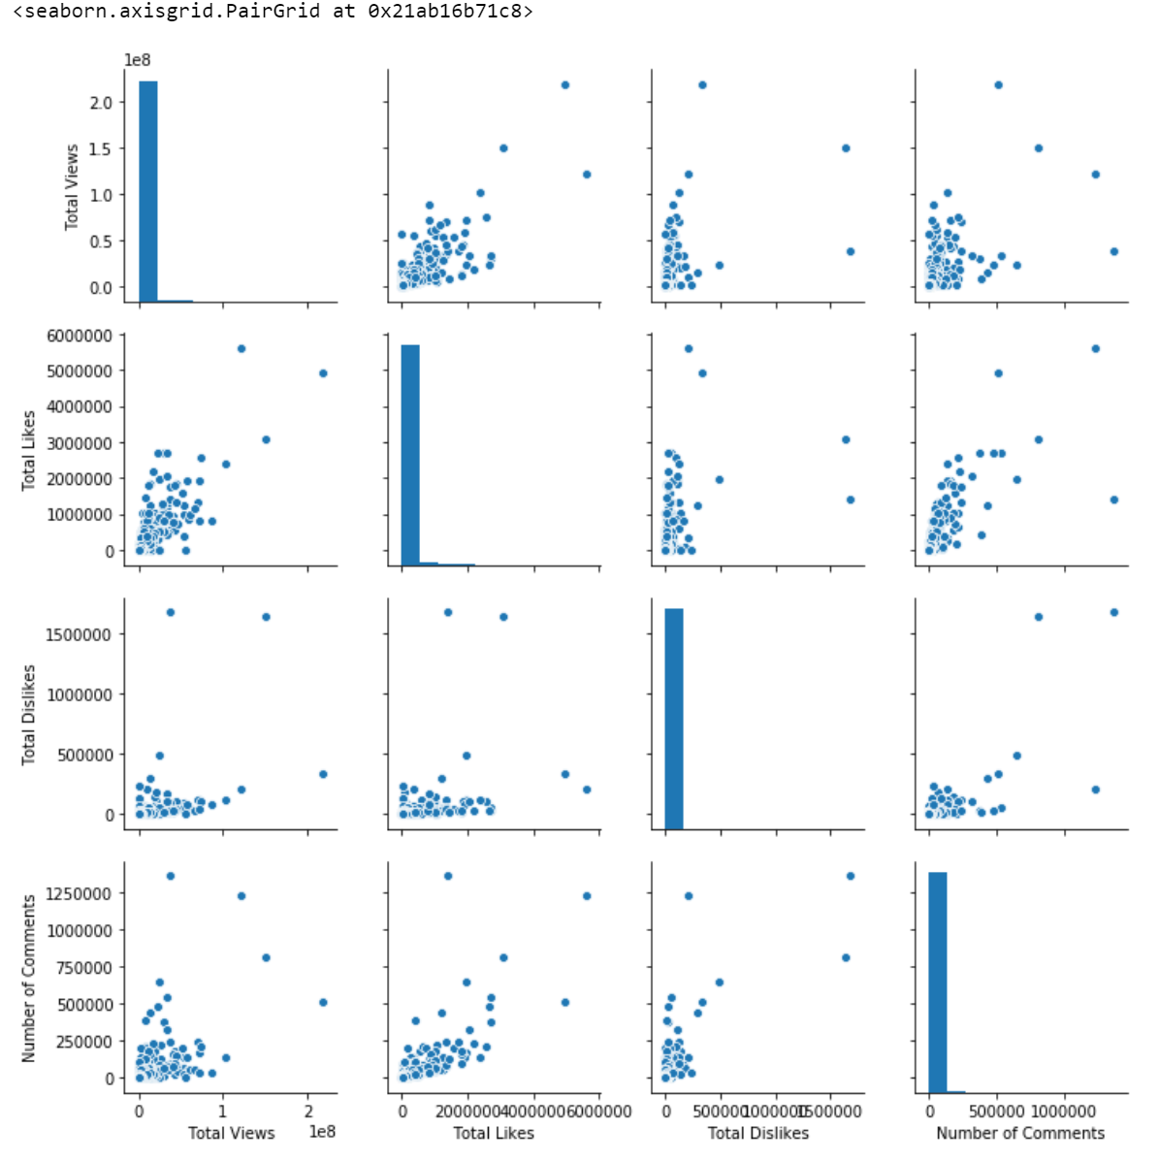

Slide 9
Notes:
Notes here:

